Slide 1
War, violence and women
Direct forms of state-perpetrated violence against women

Slide 2
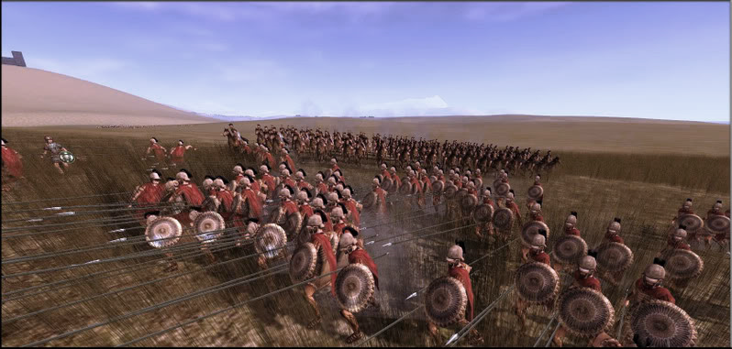
War
Since WWII 252 conflicts worldwide
  Interstate
  Intrastate
Nature of war has changed?
  1) Increased number of intrastate conflicts
  2) Military spaces
  3) Targeting of civilian populations
  4) Technology?

Slide 3
War
Historically, who makes decisions about war?
Soldiering is gendered
  Men make up 99.9 percent of all combat forces worldwide
  Dominate the political systems that control war
  Number of women heads of state?
  12 Heads of State
  13 Heads of Government

Slide 4
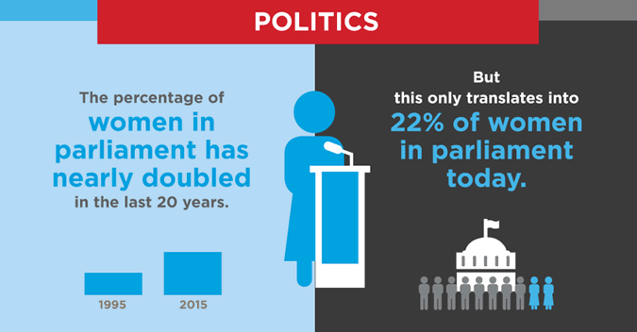
Women in politics
Which state has the most female representation in government?

Slide 5
Militarized violence
Distinct gender and sex roles during war
What are they?
  Women are bearers of ‘tradition’ and national culture
  Men the protectors of the faith/nation and its property
Endorsed and propagated by the state

Slide 6
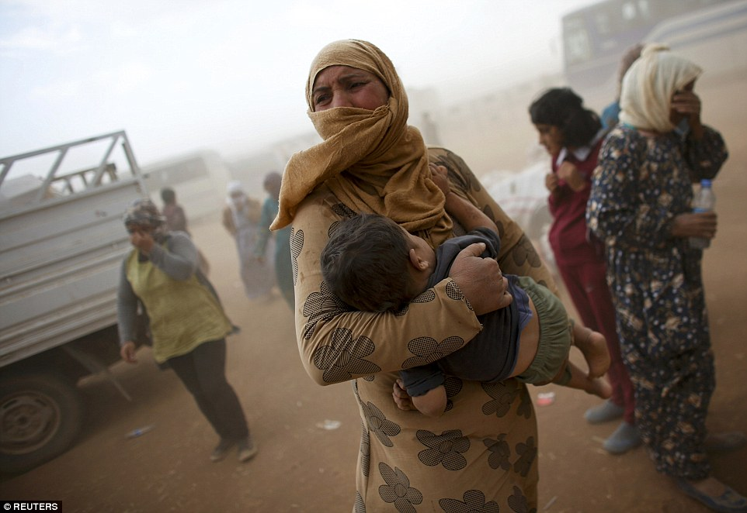
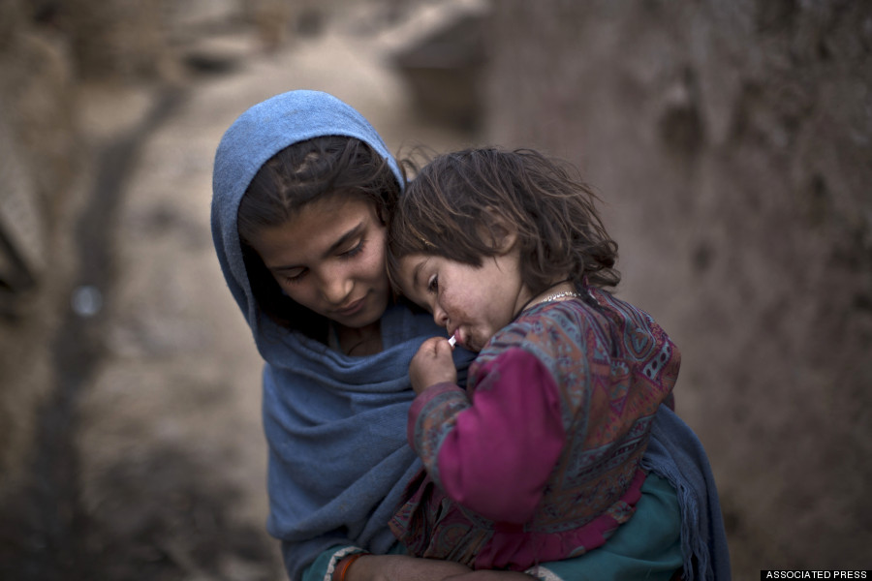
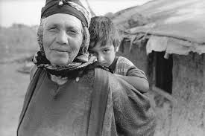
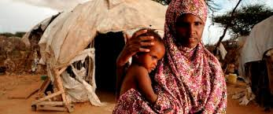
Popular images of women during war: The refugee

Slide 7
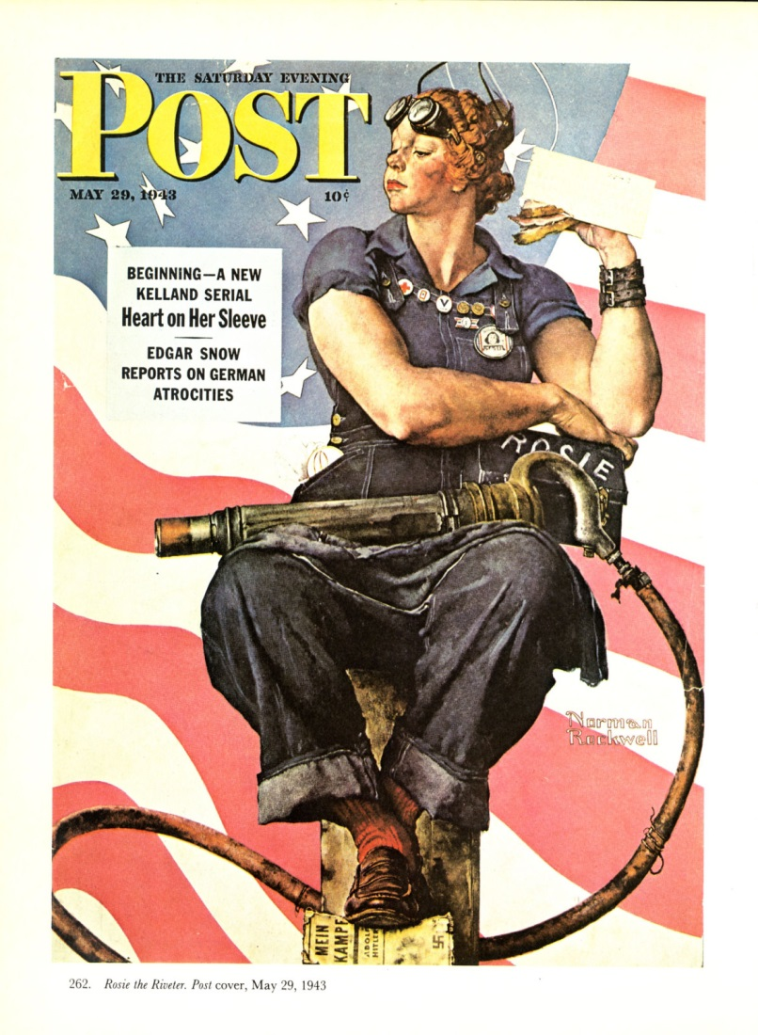



Popular images if women during war: Rosie the riveter

Slide 8
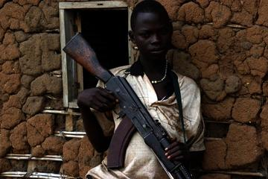
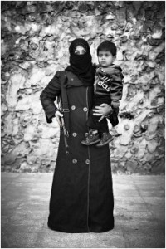
Popular images if women during war: Women combatant with child

Slide 9
Popular images of women during war
Spread by state institutions
  Symbols
“Controlling images” Patricia Hills Collins
  Serve state’s strategic interests
  Problems?
    Hegemonic experiences?
    Undermine diversity of women’s experiences

Slide 10
Importance of women to narratives of war
Knowledge of war written by who?
Yet, women linked to early accounts of war
Examples?

Slide 11
Importance of women to narratives of war
Kidnapping of Cassandra in the Odyssey leading to the fall of Troy
Rescuing of Sita by her husband in the Ramayana
Kidnapping and rape of the Sabine women

Slide 12
Types of violence perpetrated against women during war
“Rape and take spoil” – common adage
Rape defined as:
  The unlawful sexual intercourse or any other sexual penetration of the vagina, anus, or mouth of another person, with or without force, by a sex organ, other body part, or foreign object, with the consent of the victim
  Consent?

Slide 13
Types of violence against women during war
Sexual assault
Any unwanted sexual act against a person or without a person’s consent
  Includes sexual, physical verbal or visual acts that force a person against their will to have unwanted sexual contact or attention

Slide 14
Types of violence against women during war
For the purposes of:
  Measure victory
  Prove masculinity
  Reward
  Destroys indigenous familial relations
  Controls male populations

Slide 15
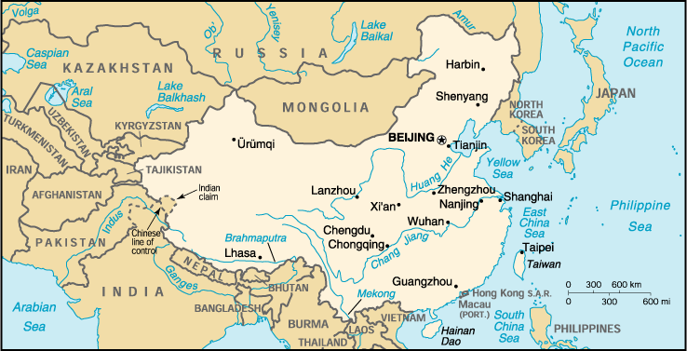
Types of violence during war
Rape of Nanking

Slide 16
Rape of Nanking
Massacre of 250,000-350,000 people
20-80,000 women and girls were raped
  Occurred in public
  Purpose was to instill fear
  Destroy families and communities
  Control the population

Slide 17
Types of violence during war
Stetz (2007) 3 conditions:
  (1) when male soldiers feel they have limitless power over women . . .;
  (2) when they believe themselves racially, ethnically, religiously, or otherwise distinct from and superior to women under their control/or believe that gender alone constitutes hierarchal differences sufficient to excuse their abuse of the subordinate party;

Slide 18
Types of violence during war
3) when they are convinced that they are acting with the approval of those higher up (whether in the military itself or within the government), even while they are violating international law.

Slide 19
Genocide and genocidal rape
Most serious of all crimes
  Definition?
Number of genocidal massacres in internal conflicts has tripled since 1968
Examples?
  Conflict occurred in former Yugoslavia 1992-1994

Slide 20
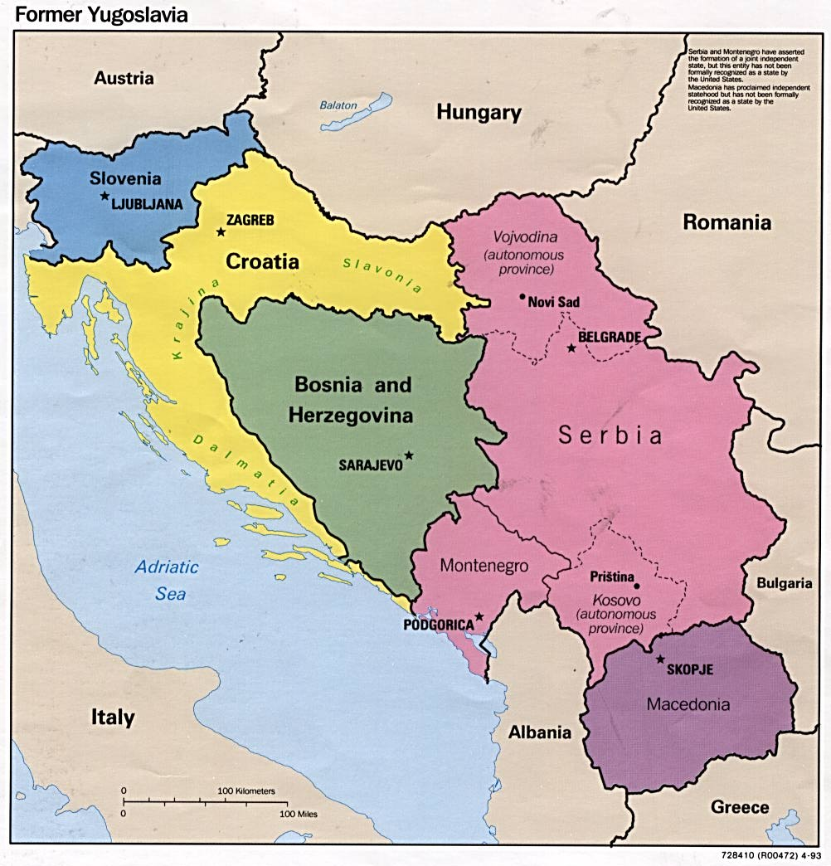
Former-Yugoslavia
Ethnic nationalist wars
https://en.wikipedia.org/wiki/Breakup_of_Yugoslavia#/media/File:Breakup_of_Yugoslavia-TRY2.gif

Slide 21
Former Yugoslavia
Bosnia-Herzegovina war
  Bosnian Muslims
  Bosnian Serbs
Rape was part of a broader policy of ethnic cleansing
Bosnian Muslim women in Foča were subjected to:
  Gang rapes
  Rapes in public space
  Multiple rapes over extended periods of time
  Forced fellatio
  Forced incest

Slide 22
Former Yugoslavia
Serb authorities not only approved the systematic rape of Muslim women in Foča but made a public display of rape at Partizan Hall [a building used as a detention facility]. One woman at Partizan was raped more than 100 times in two months (Gutman, 1992)

Slide 23
Other forms of violence
Physical violence
  “slapping, hitting, burning, kicking, shooting, stabbing, or any other form of nonsexual physical violence” (Belknap, 2007, p. 391)
Physical abuse of women is tactic of symbolic and psychological warfare
Syrian conflict?

Slide 24
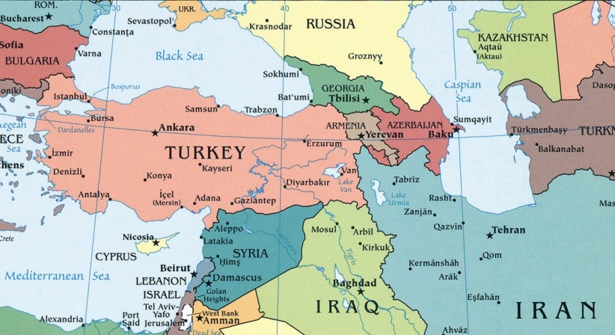
Syrian conflict
https://www.youtube.com/watch?v=K5H5w3_QTG0

Slide 25
Syria
Types of gender-based:
  Indiscriminate shelling
  Torture of men and women
    150,000 people held in custody by Assad’s regime
  Women targeted for different types of violence
  Used as human shields
  Sex-specific discrimination policies
  Denial of healthcare

Slide 26
“In December 2012, Samia and her friend Lubna were stopped by governmental forces at Al-Arbaeen checkpoint on the road connecting Al-Moadamieh and Daria (Damascus Suburb). While the security personnel were searching the women, an exchange of fire between armed groups and government troops broke out. As the clash intensified, the commander of the intelligence unit used the two women to shield himself, pushing them into the line of fire until the troops managed to reach a safe area and leave the scene” (Nasar, 2013, p. 11)

Slide 27
During my presence in the central prison of Homs, one officer asked me about the medication bag I was carrying. I said it was my medication and I need it. He threw it on the ground and said while crushing it with his foot: you have no medicine here, you can die
(Aida in Nasar, 2013, p. 19)

Slide 28
Syria
Media coverage?
Other forms of conflict violence take precedence over VAW
Removed from the politics of state
Situated within the private sphere

Slide 29
Iraq
To advance state interests
  Multinational forces detained women because of their connections to men
  Abu Ghraib
    42 women
    Sexual assault
    Torture
    Beatings

Slide 30
Consequences
Forced pregnancy
  “an impregnation that results from an assault or series of assaults on a woman perpetrated with the intent that she becomes pregnant” (Goldstein, 1993)

Slide 31
Forced conscription
Military group engages in:
  “conscripting or enlisting children under the age of 15 years into armed forces or groups or using them actively to participate in hostilities” (the Rome Statute, 1998, Article 7(e)(vii)).
Why are children valuable resources during conflict?

Slide 32
Forced Conscription
Benefits of child soldiers
  Able to carry light-weight weaponry
  Do not demand salaries
  More easily intimidated and controlled
  Less likely than adults to run away
  Agile - can be used for dangerous
  Instill fear in adult populations

Slide 33
Forced Conscription
300,000 children used in conflict worldwide
Recruitment
  Abduction
  Extreme pressure
  Join on own volition
    Survival
    Revenge
    Protection
    Attracted to culture

Slide 34
Forced Conscription
Abusive behaviors
  Extreme acts of violence
  Test loyalty
  Forced to take drugs
Violence specific to girls
  Domestic “duties”

Slide 35
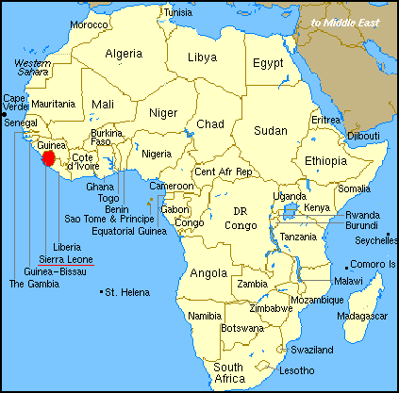
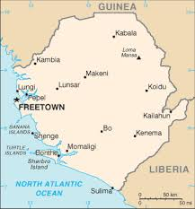
Sierra Leone

Slide 36
Sierra Leone
Revolutionary United Front (RUF)
“I was responsible for cooking, and I always did it well because I did not want to leave the [domestic duties] [sic] for jobs like combat that were more deadly” (p. 49).

Slide 37
Sierra Leone
Patriarchal gender roles:
  Forced to marry commanders
  Hyper-masculinity
  Resources
  Rewards
  Protection?

Slide 38
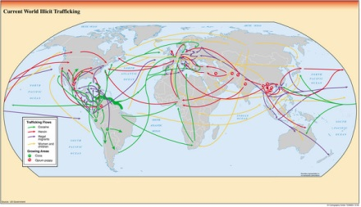
Slavery and human trafficking
What is human trafficking?
Why is the related to conflict?

Slide 39
Slavery and human trafficking
Occupation of Iraq
  3,500 women have gone missing between 2003 and 2007 (Dakkak, 2007)
How is this related to state?
State response:
The “issue was just too sensitive” (Human Rights Watch, 2010b).

Slide 40
Women displaced by conflict
Refugee versus IDPs?
  Heightened insecurity
  Risk of further violence
Not just restricted to times of conflict?

